Slide 1
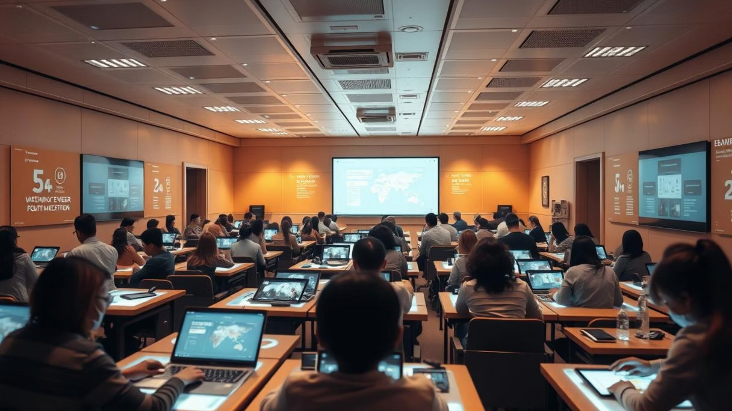

AI-Powered Personalized Learning for Quality Education
Bridging Educational Gaps with Gemini AI
Presented by: Data Detectives
Yashraj Awatade, Riyan Mujawar, Yash Khupse,Riya Surve
Yashwantrao Chavan Institute Science, Satara

Slide 2
Introduction: Redefining Education Access
Access to quality education remains a significant barrier for many underprivileged communities worldwide. Traditional educational models, often rigid and one-size-fits-all, frequently fail to engage students effectively, leading to widespread disinterest and alarmingly high dropout rates.
This is where the transformative potential of AI comes into play. By leveraging artificial intelligence, we can move beyond conventional approaches and enable truly adaptive, personalized learning experiences that cater to the unique needs of every student, fostering engagement and improving outcomes.

Slide 3
The Learning Gap: Beyond Basic Access
Despite a wealth of online educational resources, underprivileged students often face critical limitations that hinder their progress. They lack:
Personalized Learning Paths
Contextual Content
Motivation & Engagement
Learning materials often aren't adapted to their specific backgrounds or real-world relevance.
No tailored content or progression to match individual pace and prior knowledge.
Lack of interactive elements and dynamic feedback leads to disengagement.
There is a pressing need for a smart system that intuitively understands each learner's pace, preferences, and individual needs, creating an engaging and effective educational journey.

Slide 4



Our Objective: An Intelligent Learning Companion
Our primary objective is to build an advanced AI-powered personalized learning assistant utilizing Google's Gemini AI. This system will be designed to:
Generate Custom Q&A
Deliver Interactive Sessions
Enhance Comprehension & Retention
Dynamically create topic-wise questions and answers tailored to the student's current understanding.
Facilitate engaging, real-time learning conversations, adapting to student responses.
Utilize adaptive strategies to reinforce learning and ensure long-term knowledge retention.

Slide 5

Why This Problem Matters: Global Impact
Addressing this challenge is crucial for several reasons:
Global Alignment: Our initiative directly supports UN Sustainable Development Goal 4: Quality Education, striving for inclusive and equitable education for all.
Closing Access Gaps: Marginalized communities often lack access to qualified teachers, dedicated mentors, and well-structured, relevant content. AI can bridge these critical gaps.
Democratizing Education: By providing personalized learning tools, AI can democratize education, making high-quality instruction accessible regardless of geographical or socioeconomic barriers. It empowers independent learners to take charge of their educational journey.

Slide 6
Solution Overview: A Dynamic Learning Platform
Our proposed solution is an AI-based platform designed to dynamically adapt and respond to learner inputs, creating a truly personalized educational experience.
01
02
Smart Q&A Generator
Adaptive Learning Paths
Generates relevant questions and detailed answers on any topic, adapting difficulty based on performance.
Adjusts the learning curriculum in real-time, recommending the next best steps for each student.
03
04
Progress Tracking
Multilingual & Inclusive UI
Monitors student progress, identifies areas for improvement, and provides targeted feedback.
Future scope includes support for multiple languages and an interface optimized for diverse accessibility needs.

Slide 7
Key Features: Empowering Every Learner
Our personalized learning assistant comes equipped with core features designed to maximize impact and engagement:
1
2
3
Custom Question Generation
Personalized Topic Recommendations
Optimized for Accessibility
Ability to generate questions based on specific subjects and types (e.g., Multiple Choice, Descriptive, True/False), allowing for varied assessment and practice.
Intelligent algorithms recommend the next logical topics or remedial content based on the student's performance and learning style, ensuring a smooth and effective progression.
Designed with a focus on low-resource environments, ensuring the platform is lightweight and accessible even on basic or older devices, bridging the digital divide.

Slide 8
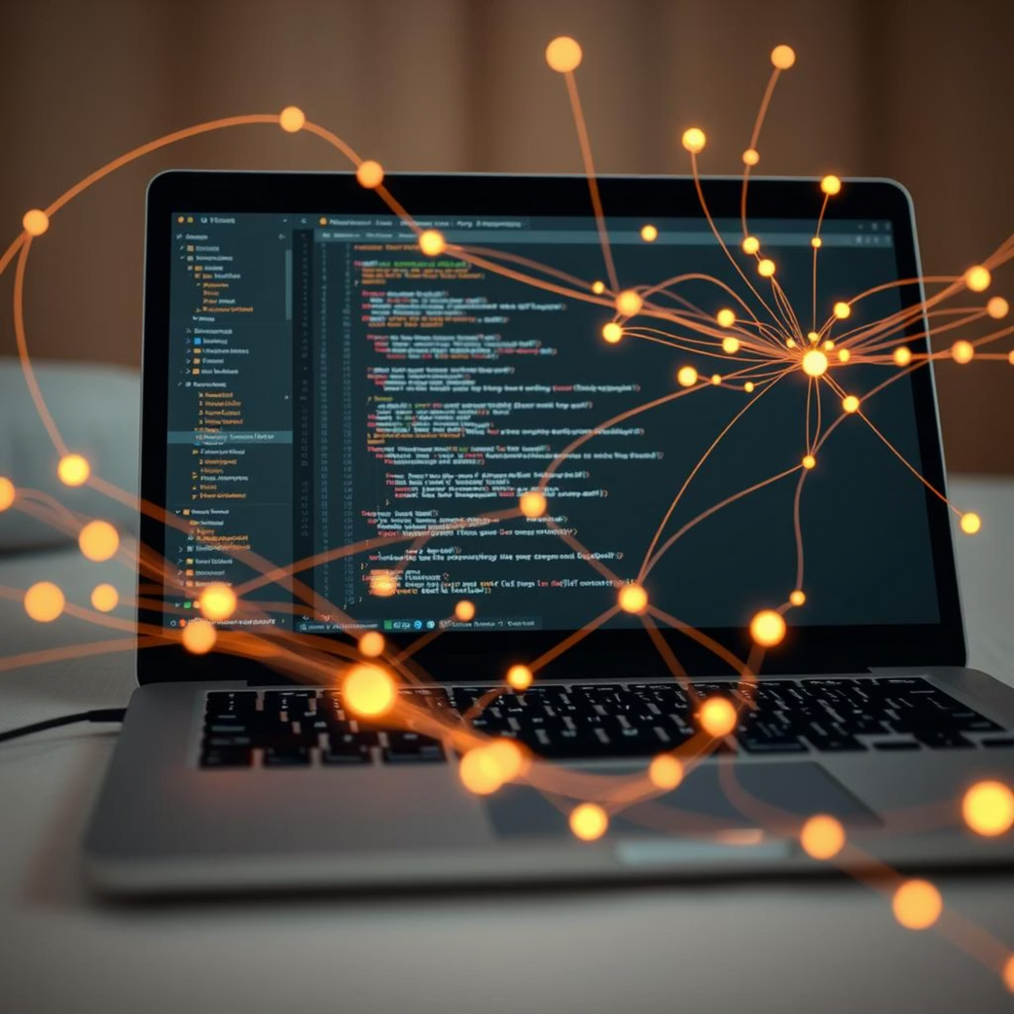
Technical Implementation: The Core Architecture
Our prototype leverages powerful, accessible technologies to bring personalized learning to life:
1
Google Gemini API
The backbone of our system, Gemini AI drives sophisticated content generation, understanding nuances in topics and delivering coherent, context-aware responses and questions.
2
Python + IPyWidgets on Colab
Our interactive user interface prototype is built using Python, harnessing the power of IPyWidgets within a Google Colab environment for rapid development and demonstration.
Future-Ready: The modular design of our prototype ensures it can be seamlessly integrated into dedicated mobile or web applications for broader deployment, scaling the solution to millions of users.

Slide 9
Why Gemini? The AI Advantage
We chose Google Gemini as the core AI engine for its unparalleled capabilities, offering significant advantages for our educational platform:
Coherent & Context-Aware
Scalable & Integrable
Multimodal & Extensible
Gemini excels at generating highly relevant, coherent, and contextually appropriate educational content, from complex explanations to nuanced questions, ensuring deep understanding.
Its robust API design allows for easy integration into various platforms and applications, ensuring our solution can scale to meet the demands of a global user base.
Gemini's multimodal capabilities open doors for future enhancements, including incorporating images, audio, and video to enrich learning. Its extensibility allows for continuous evolution of the platform.

Slide 10
Expected Outcomes: A Brighter Educational Future
Our AI-powered personalized learning assistant is poised to deliver significant positive outcomes:
⬆️
🌍
🌱
Increased Engagement
Expanded Access
Ecosystem Foundation
Higher learner engagement and deeper comprehension due to personalized, adaptive content.
Better access to quality education, particularly in low-resource regions, bridging existing educational divides.
Lays the groundwork for a scalable, sustainable AI education ecosystem, fostering continuous learning and innovation.
This project aims to empower individuals with the knowledge and skills they need to thrive, contributing to a more educated and equitable world.

Slide 11
project link:https://colab.research.google.com/drive/1IC7MFT8FSfldu5O1aFNLA1n-h5fVQ4hd?usp=drive_link
document link:https://drive.google.com/drive/folders/1chOo3OXQ8U2Ar8Z-lmDpRXo3uWqqbqIe?usp=drive_link

